Slide 1
Dsc 478 Machine learning applications: Final Project
Joel Fernandez
Elizabeth Kerrigan
Wills McKenna

Slide 2

Dataset and Project Proposal
The Spotify 1921-2020 dataset taken from Kaggle is a rich collection of musical data that explores songs and their characteristics across many different styles and time periods. Each row in the dataset corresponds to a song, and attributes of each song include year it was made, name of artist, and length of song in milliseconds. It also includes unique attributes that describe the song itself, including danceability, acousticness, and valence, which Spotify calls the “musical positiveness conveyed by a track”.
Intention:
Create a playlist for a user based on song choice from a list
Create a playlist for a user based on input features like acousticness or instrumentalness

Slide 3
Process Overview
Data exploration and pre-processing
Dimensionality Reduction using PCA
Discover classes through clustering like Kmeans and DBSCAN
Validate classes using KNN classification
Demonstrate the App

Slide 4
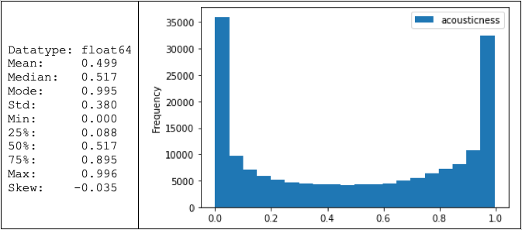
Data Exploration – Acousticness A confidence measure from 0.0 to 1.0 of whether the track is acoustic. 1.0 represents high confidence the track is acoustic. It Does not follow a normal distribution. Most of the acousticness appears to occur in the .00 and .95 range.

Slide 5
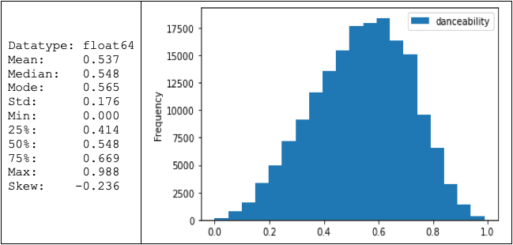
Data Exploration – Danceability Describes how suitable a track is for dancing based on a combination of musical elements including tempo, rhythm stability, beat strength, and overall regularity. A value of 0.0 is least danceable and 1.0 is most danceable. It's not quite a normal distribution, it appears to skew to the left.

Slide 6
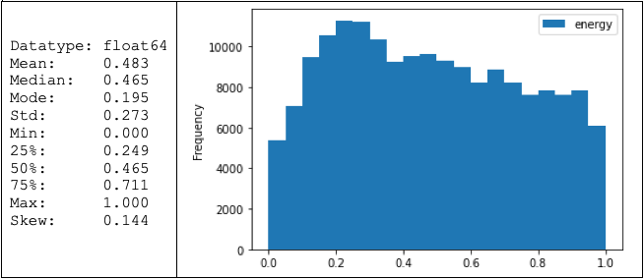
Data Exploration – Energy Energy is a measure from 0.0 to 1.0 and represents a perceptual measure of intensity and activity. Typically, energetic tracks feel fast, loud, and noisy. It Does not follow a normal distribution. The distribution skews to the right.

Slide 7
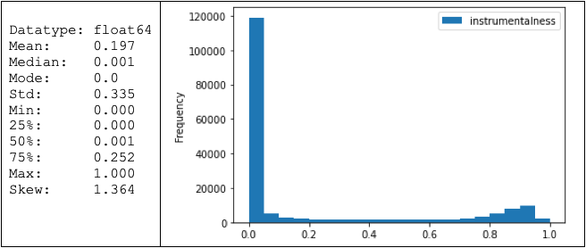
Data Exploration – Instrumentalness Predicts whether a track contains no vocals. “Ooh” and “aah” sounds are treated as instrumentals. in this context. Rap or spoken word tracks are clearly “vocal.” The closer the instrumentalness value is to 1.0, the greater likelihood the track contains no vocal content and is purely instrumental, It Does not follow a normal distribution. Appears to skew to the right. Most of the instrumentalness occurs at the .00 range.

Slide 8
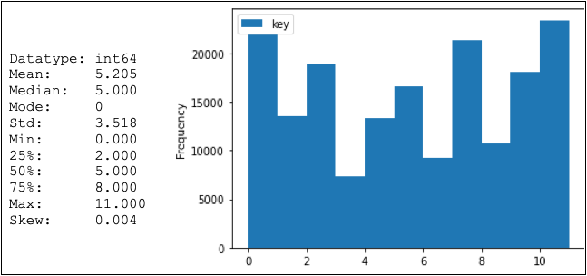
Data Exploration – Key Represents The musical key the track is in. Integers map to the pitches using standard Pitch Class notation. E.g. 0 = C, 1 = C♯, D♭, 2 = D, 3 = D♯, E♭, 4 = E, 5 = F, 6 = F♯, G♭, 7 = G, 8 = G♯, A♭, 9 = A, 10 = A♯, B♭, 11 = B https://en.wikipedia.org/wiki/Pitch_class It Does not follow a normal distribution. It appears to be sparsely populated, which makes sense as there is no one dominant key in all of western music.

Slide 9
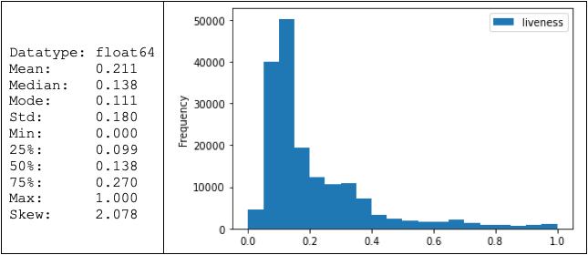
Data Exploration – Liveness Detects the presence of an audience in the recording. Higher liveness values represent an increased probability that the track was performed live. A value above 0.8 provides strong likelihood that the track is live. It Does not follow a not follow a normal distribution. Appears to skew to the right. Most of the liveness occurs at the .1 range.

Slide 10
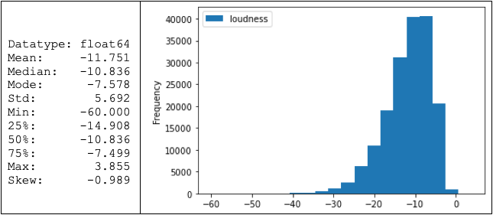
Data Exploration – Loudness Loudness is the quality of a sound that is the primary psychological correlation of physical strength (amplitude). Values typically range between -60 and 0 db. It Does not follow a normal distribution. Appears to skew to the left. Most of the loudness occurs at -10db.

Slide 11
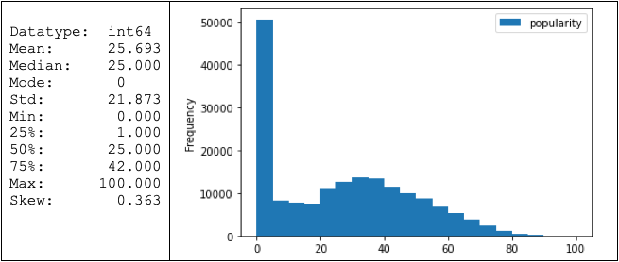
Data Exploration – Popularity The higher the value the more popular the song is. It Does not follow a normal distribution. Appears to skew to the right. Can't explain what’s going on around the 0 range. But it Could be due to there being a high number of songs that Haven’t even been listened to on Spotify.

Slide 12
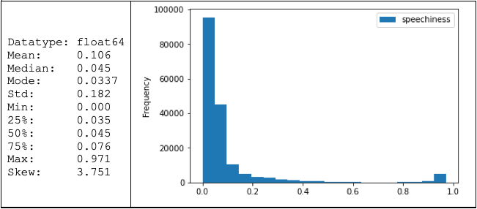
Data Exploration – Speechiness Speechiness detects the presence of spoken words in a track. The more exclusively speech-like the recording (e.g. talk show, audio book, poetry), the closer to 1.0 the attribute value. Values above 0.66 describe tracks that are probably made entirely of spoken words, such as audio-books. Values between 0.33 and 0.66 describe tracks that may contain both music and speech, either in sections or layered, including such cases as rap music. Values below 0.33 most likely represent music and other non-speech-like tracks. It Does not follow a normal distribution. Appears to skew to the right. Most of the speechiness occurs at the 0.0 range.

Slide 13
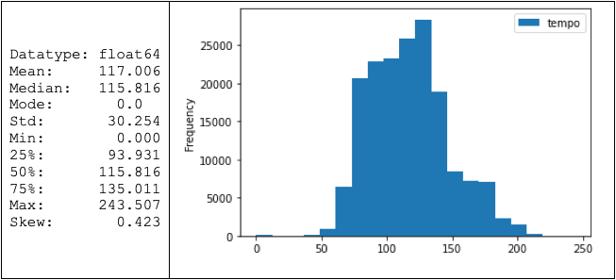
Data Exploration – Tempo The overall estimated tempo of a track iS beats per minute (BPM). In musical terminology, tempo is the speed or pace of a given piece and derives directly from the average beat duration. Although the distribution almost looks normal. Skews to the right, but not by much. Can't explain why the mode is 0. Requires further investigation.

Slide 14
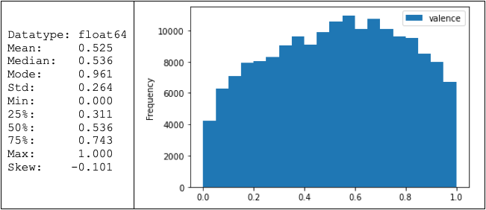
Data Exploration – Valence A measure from 0.0 to 1.0 describing the musical positiveness conveyed by a track. Tracks with high valence sound more positive (e.g. happy, cheerful, euphoric), while tracks with low valence sound more negative (e.g. sad, depressed, angry). It Does not follow a normal distribution. It appears to skew to the left.

Slide 15
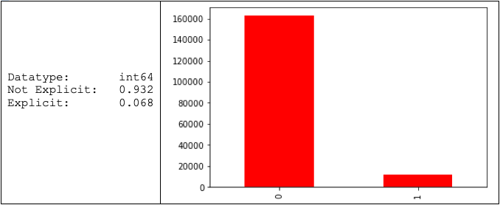
Data Exploration – Explicitness: Indicates if explicit language was used in the song. 93% of the songs were not explicit and 7% of the songs were explicit.

Slide 16
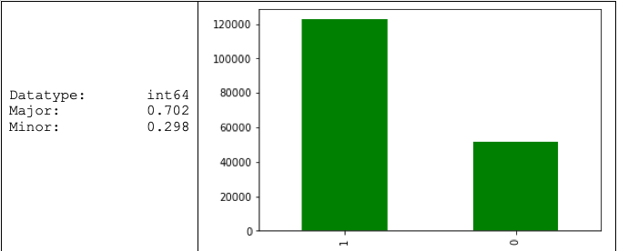
Data Exploration – Mode: Mode indicates the modality (major or minor) of a track, the type of scale from which melodic or harmonic content is derived. Major is represented by 1 and minor is 0. 70% of the melodic content has a major modality and 30% has a minor modality.

Slide 17
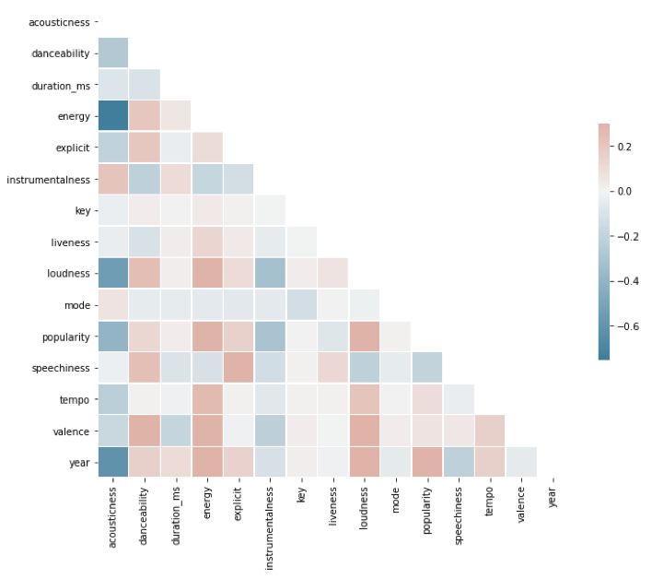
Data Exploration – Correlation Matrix After viewing the correlation matrix, there weren't any high correlation candidates for feature reduction. Acousticness and energy appears to be the most significant correlation, but still not enough for Feature Reduction.

Slide 18
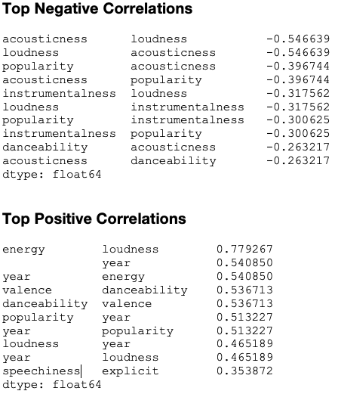
Data Exploration – Correlation Matrix

Slide 19
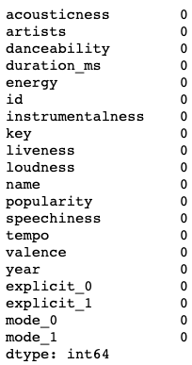
pre-processing Performed the following tasks: 1) Checked for null values

Slide 20
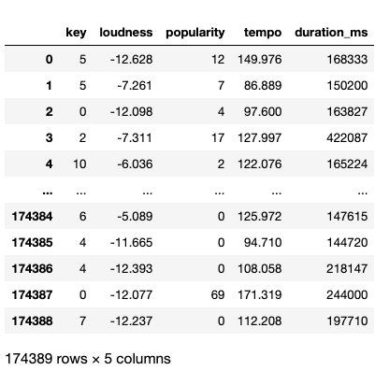
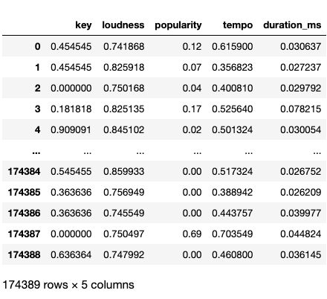
pre-processing 2) Of the 16 numeric attributes, 5 attributes ('key', 'loudness', 'popularity', 'tempo’, 'duration_ms') needed additional normalization

Slide 21
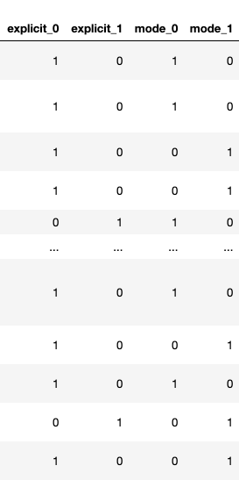
pre-processing 3) 2 categorical attributes ('explicit', 'mode') required dummy attribute conversions.

Slide 22
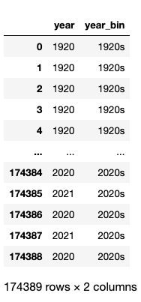
pre-processing 4) Binned the 'year' and 'release_date' attribute for every 10 years. 5) Binning 'release_date' would produce the same results as 'year'. Attribute is redundant, so it will be dropped from the dataframe.

Slide 23
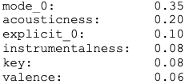
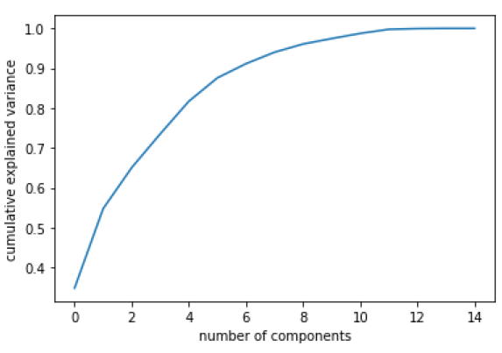
Principal Component Analysis 6 Attributes accounted for 0.88 of the variance. Scree Plot

Slide 24
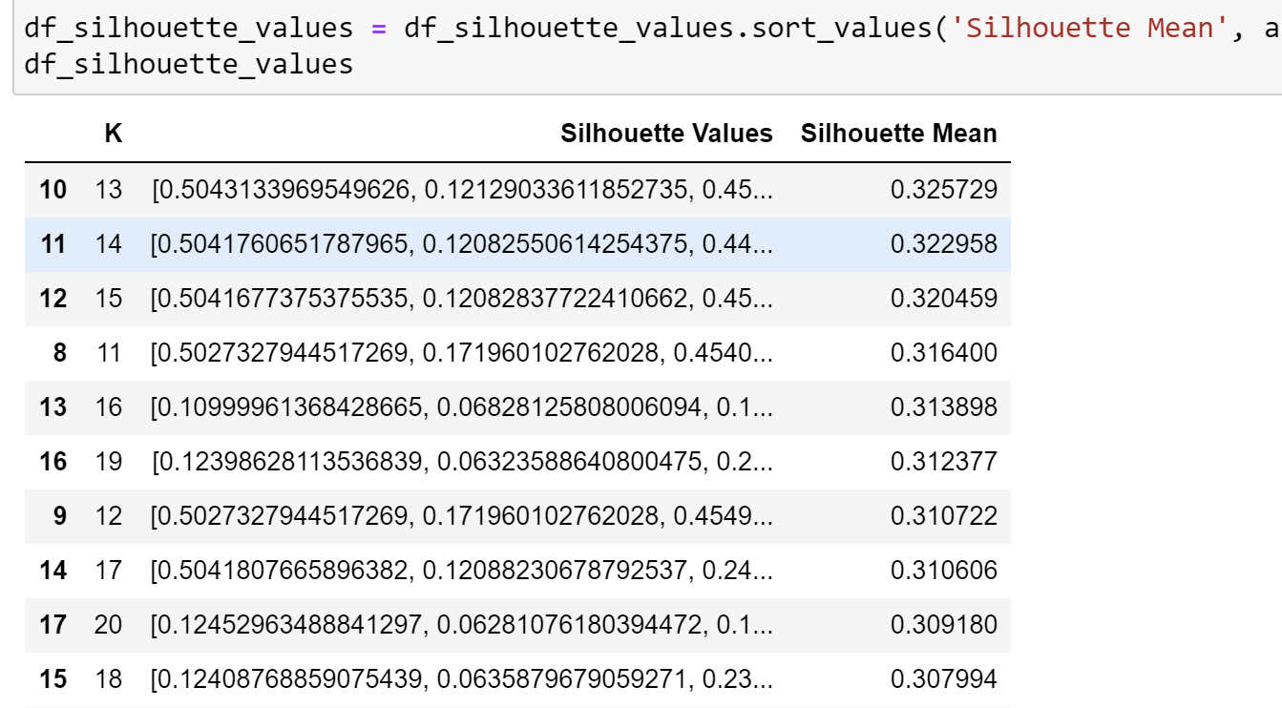
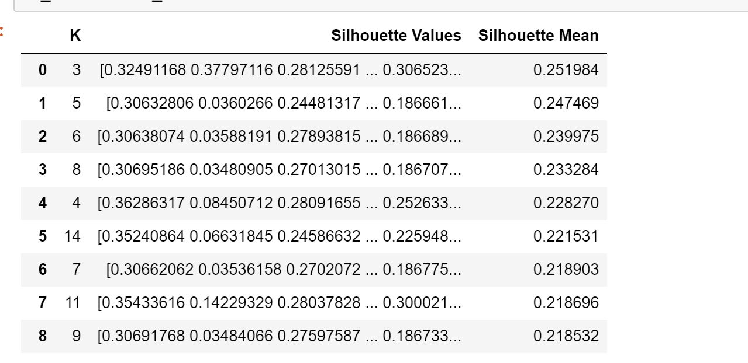
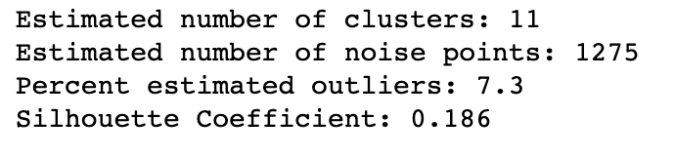
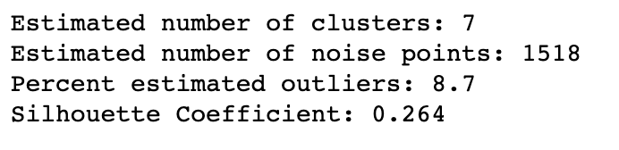
K-means
With PCA
WITHOUT PCA
DBSCAN
With PCA
WITHOUT PCA
K-MEANS clustering using features from PCA had the highest silhouette values. We will use K-MEANS with PCA for our classification and application development.

Slide 25
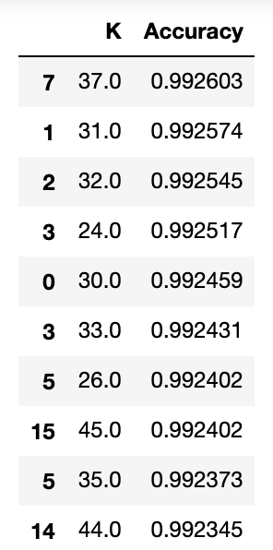
Classification using KNN
Using knn on the K-means with PCA clusters we found k = 37 to yield the highest accuracy

Slide 26
Demonstration of app
https://vimeo.com/523490396/1f4be6bbce

